Slide 1

TOUCHWIPE
AN INITIATIVE TOWARD CYBER SECURITY AND INNOVATION

Slide 2
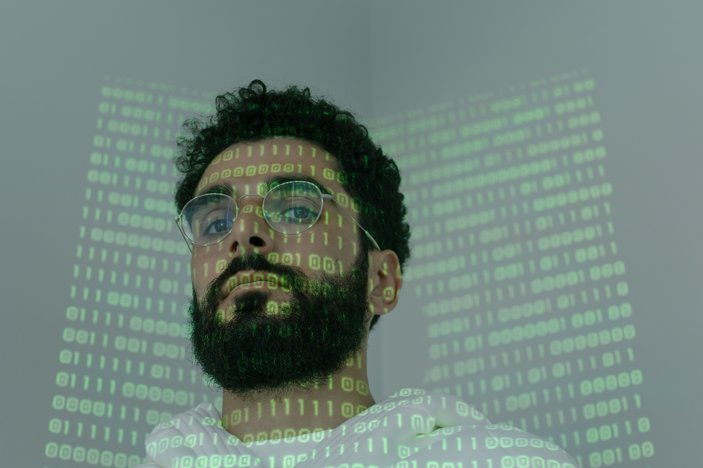
GROWING CYBER CRIME
PROBLEM STATEMENT AND SOLUTION
Researchers have shown that by using a thermal-imaging camera to look at a computer keyboard, smartphone screen, or ATM keypad, it's possible to take a picture that reveals the recent heat signature from fingers touching the device.
These images of keyboards, screens, or biometrics can then be analyzed by AI to correctly guess computer passwords in seconds.
To protect our systems we came up with an Arduino-based cleaner that will clean and cool down the surfaces of the devices- Touchwipe. Let us explore this further through a video!

Slide 3

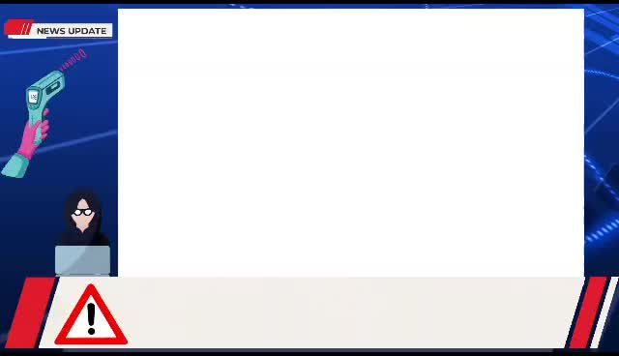
WORKING OF TOUCHWIPE

Slide 4
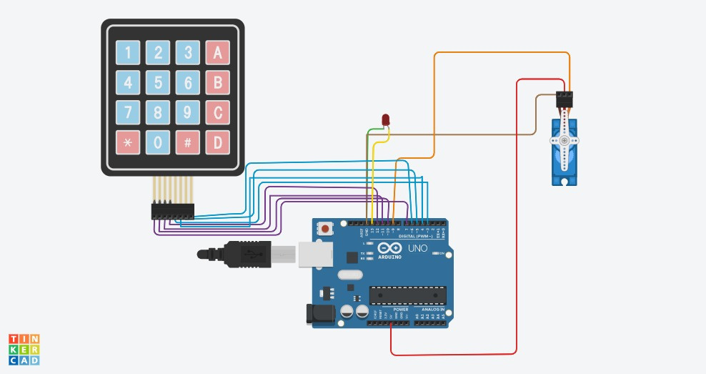

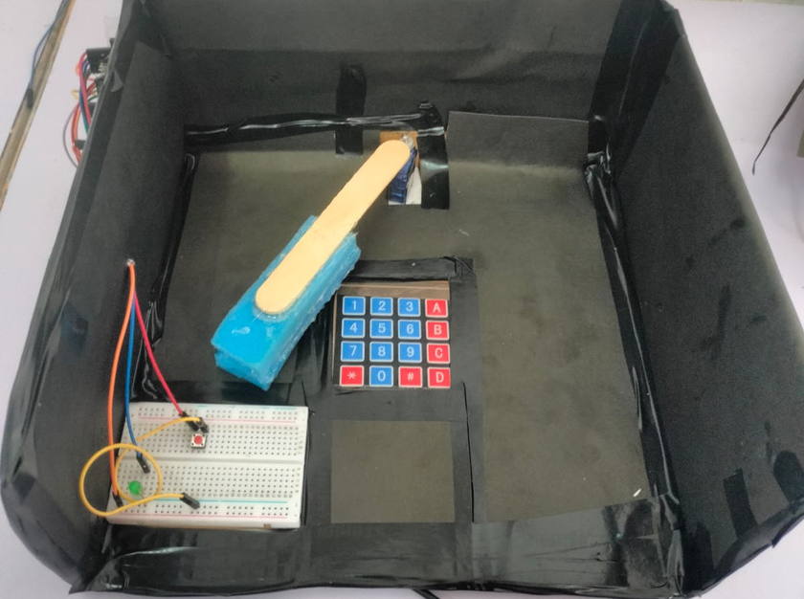
CIRCUIT DIAGRAM
The Arduino board is connected to a servo motor, an LED, a button, and a keypad.
A stick with a sponge attached to it is connected with the servo motor
The servomotor rotates 90 degrees back and forth to clean the surface of the keypad when a person ends their session by pressing the clear button .
The LED lights up to indicate the that cleaning process is ongoing and turns off immediately when the process ends.

Slide 5
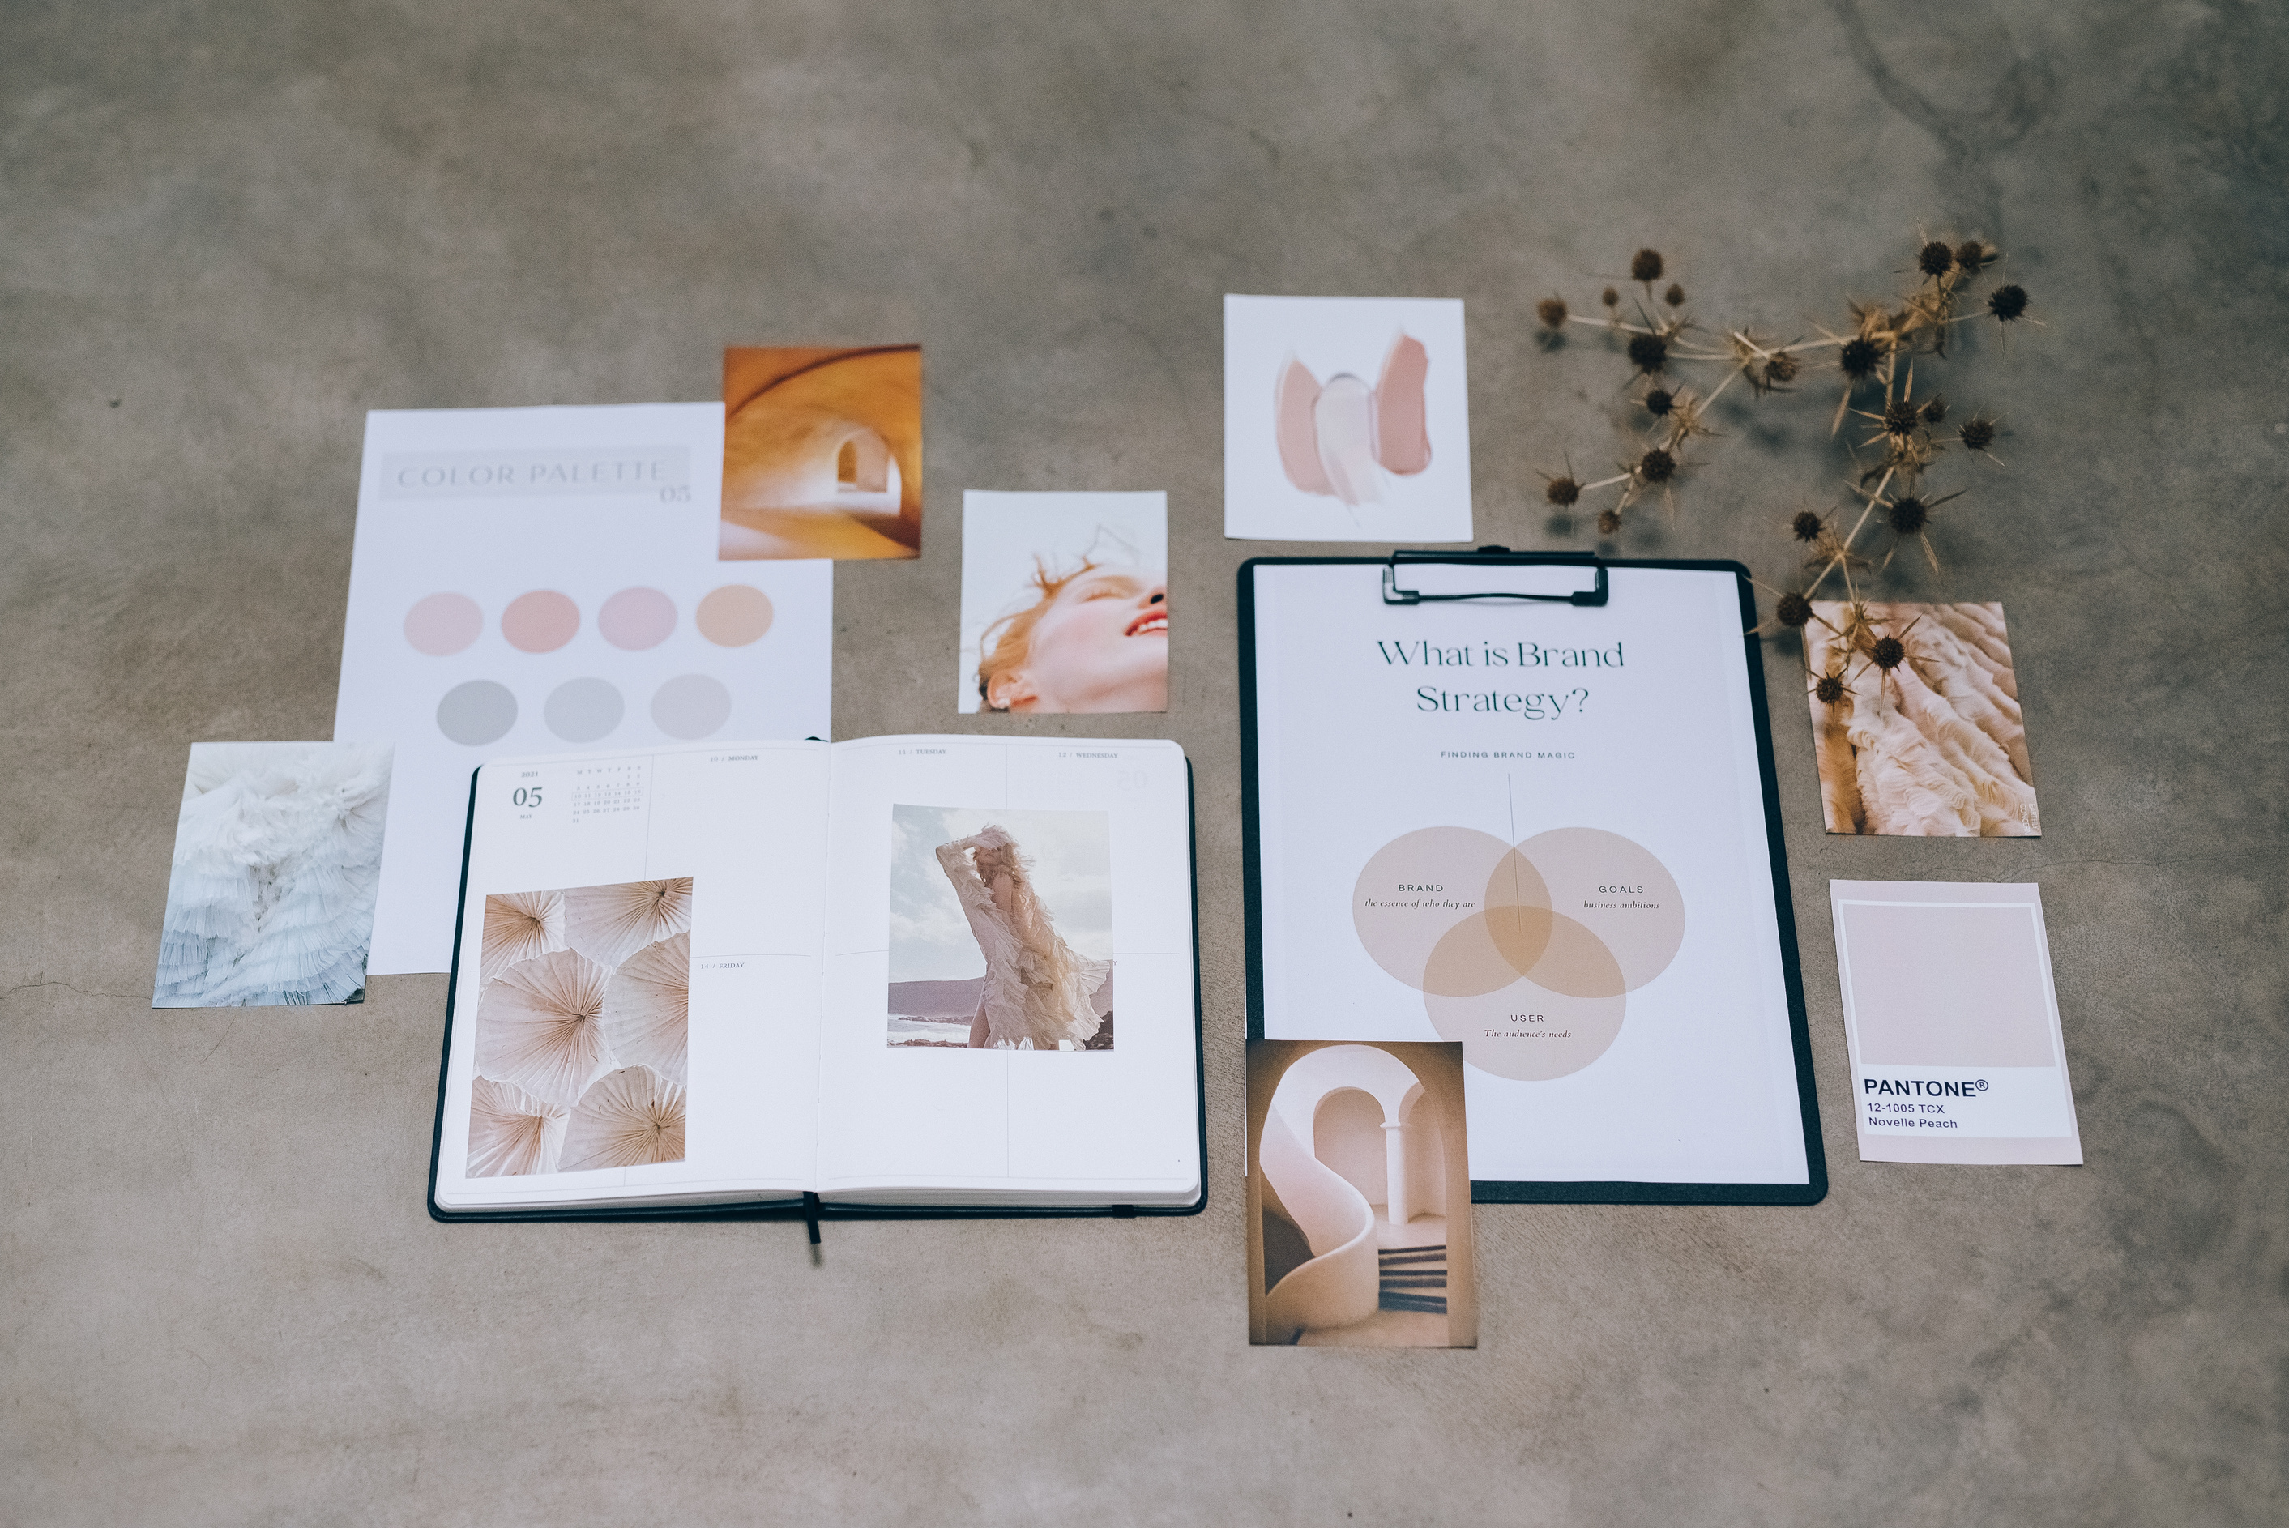

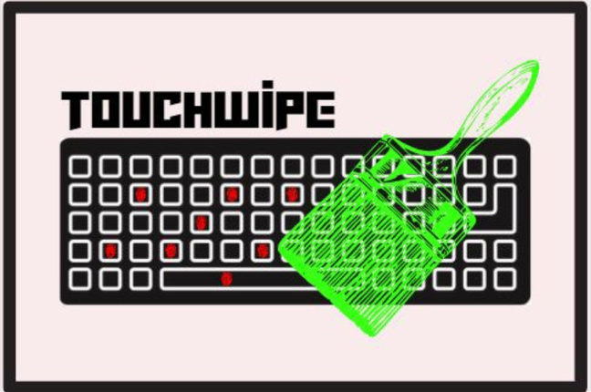

BRANDING
BE SAFE ONLINE,
REMOVE THE THREAT OF CYBERCRIME
The fluorescent red fingerprints on the keys show the threat our keyboards possess.
The brush on top of the keyboard shows that it is removing the fingerprints.
Our color scheme - black and green symbolizes safety, security, and growth
Our slogan lays emphasis on SDG 9 . We aim to create industries of innovation. We need to have a more secure and safe approach toward online password-related transactions.
It is an effective tool for making the brand more memorable.
It is simple and conveys the message needed.

Slide 6

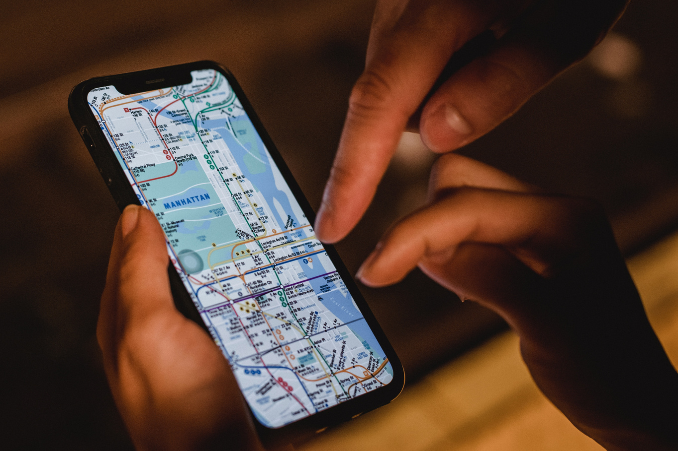
S
W
0
T
Innovative idea with an utapped market
Preliminary verison prototype with less aesthetic appeal
Growing concern of Cyber Security
The reluctance of people to adopt new technology

Slide 7

MARKET ANALYSIS AND TARGET AUDIENCE
West India
10%
North India
40%
East India
25%
Inclusive and supportive of 'For Everyone, Everywhere"', our target audience ranges from adolescents to senior citizens in advancing metropolitan cities to the remotest parts of our country. Our vision forsees the expansion of TouchWipe across the Globe too.
South India
25%
INDIAN BIOMETRIC AUTHENTICATION IDENTIFICATION MARKET
Source: https://www.maximizemarketresearch.com/market-report/india-biometric-authentication-identification-market/52158/

Slide 8
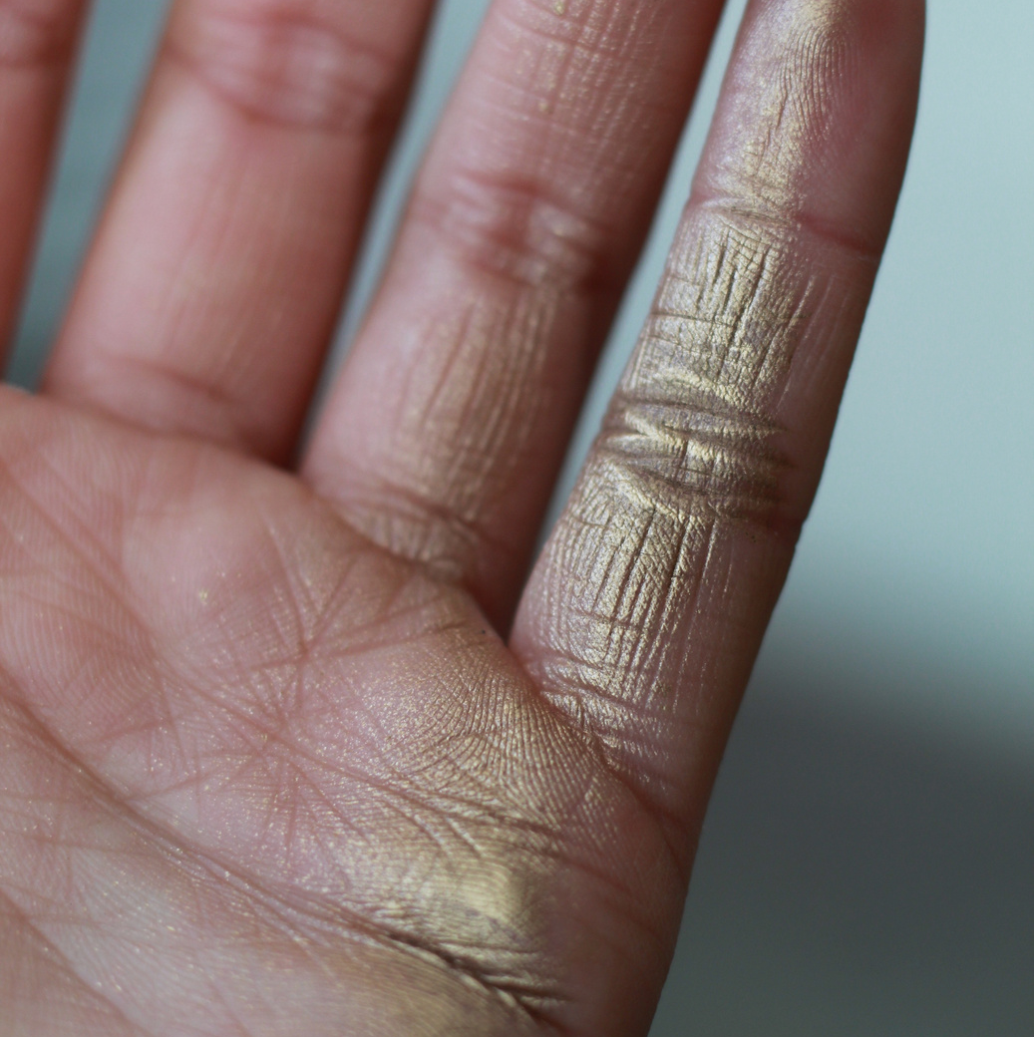
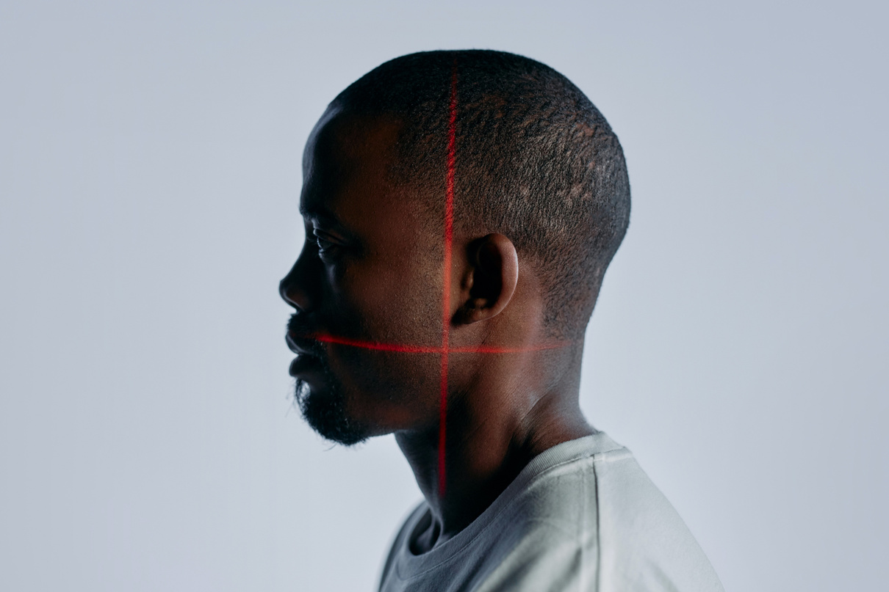
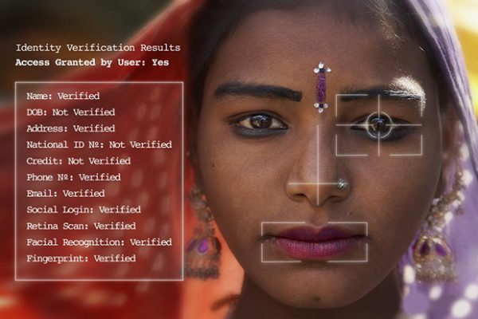
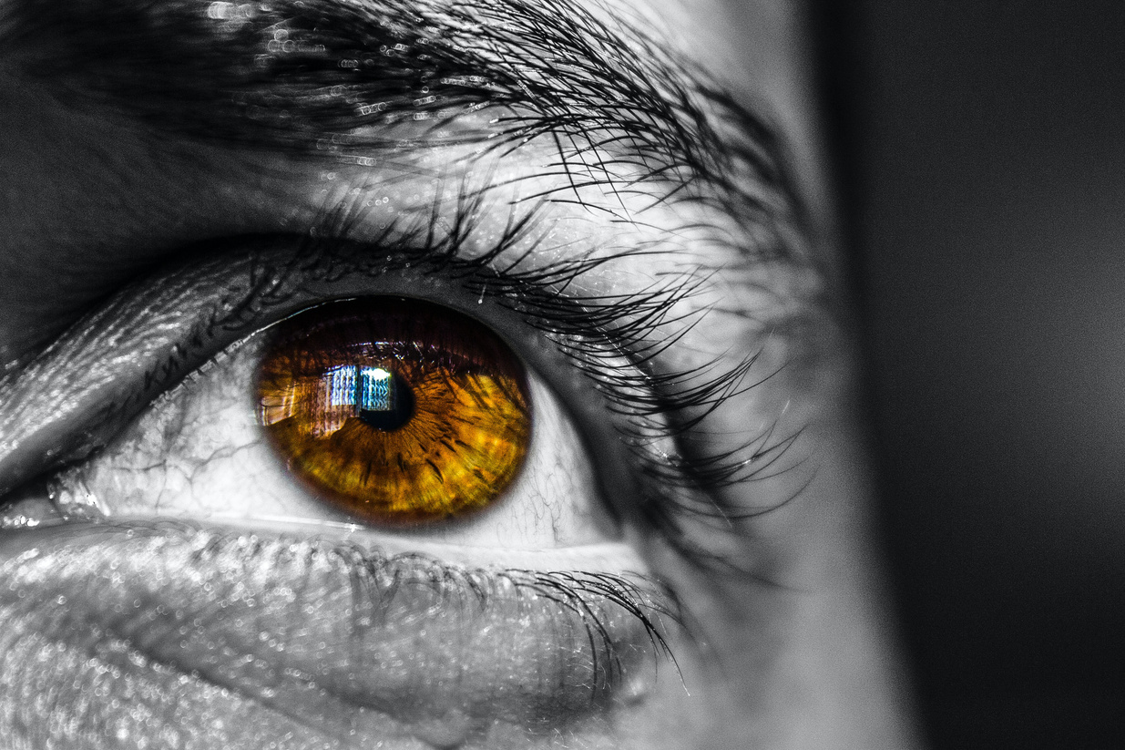
FUTURE PROSPECTS
Upholding our motto 'Safe Secure Satisfied', we aim towards expaning into the fields of other biometric related safety measures like Face Scanning, Iris Recognition, Palm Scanning, etc.
Safe
Secure
Satisfied

Slide 9
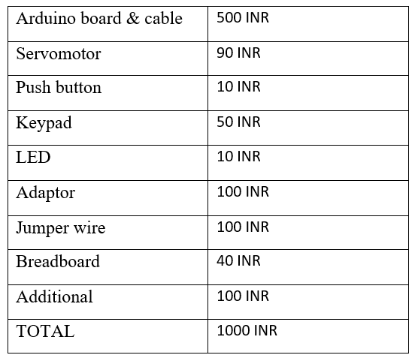
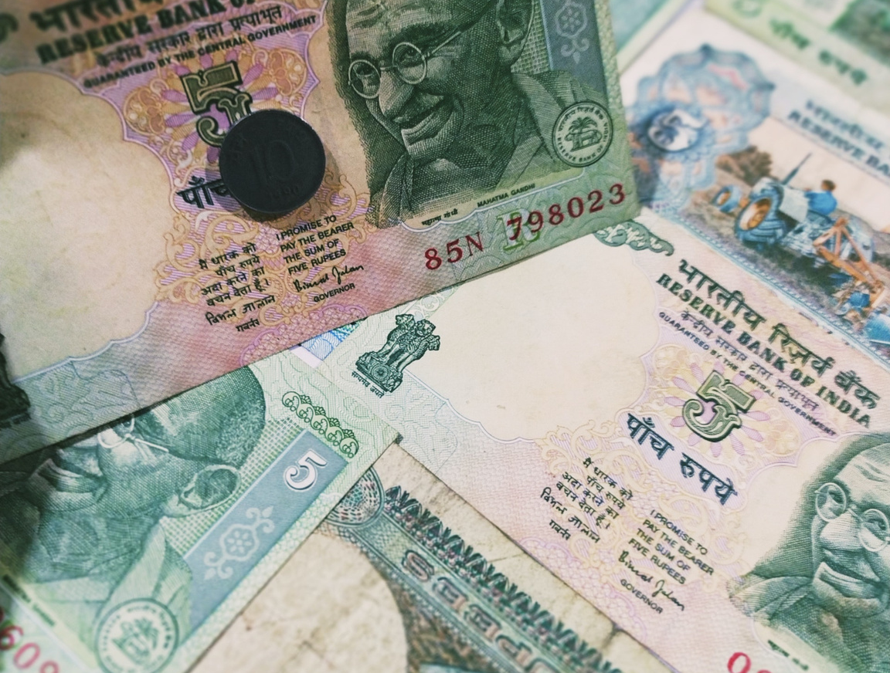
COST ANALYSIS

Slide 10
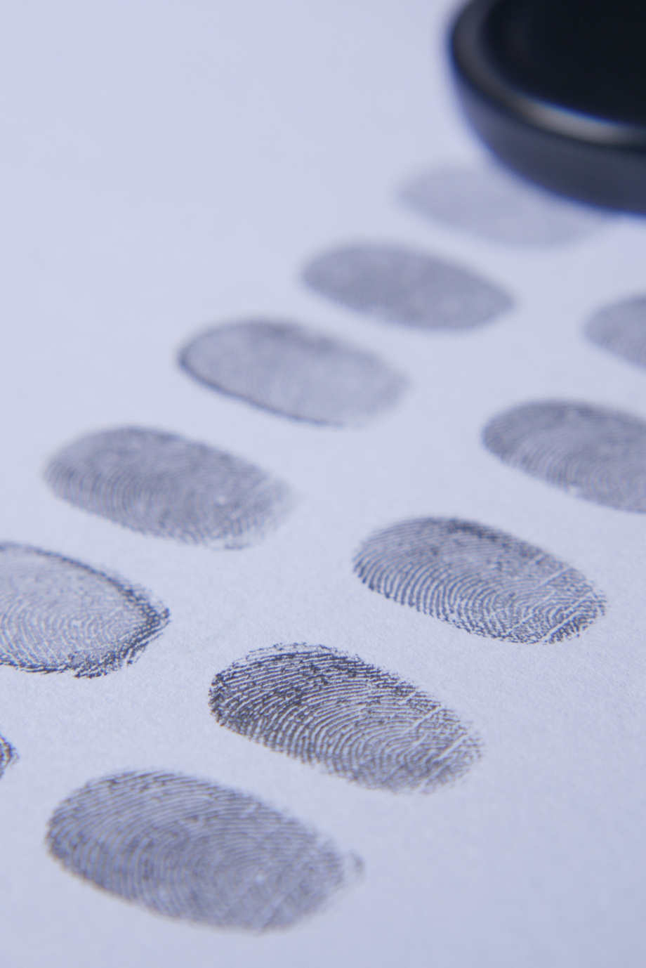
TOUCHWIPE
LET'S
CONNECT
WITH US

